Slide 1

A smart system for Personalized Interior Design and Augmented Reality Try-On
Presented By:-
Mohitha Bandi (22WUO0105037)
Pailla Bhavya (22WUO0105020)
T. Harshavardhan Reddy(2WUO0105023)
Supervised by:-
Dr. Bhargav Prajwal Pathri,
Assistant Professor,
Woxsen University.

Slide 2

Introduction
Interior design makes spaces look good and comfortable, but many people struggle to imagine furniture in their homes.
90% of users struggle to visualize furniture in their rooms before purchasing. This leads to wrong choices and dissatisfaction.
We want to built a smart system that makes interior design more accurate, interactive, and user-friendly, reducing mistakes and improving satisfaction.
Our system bridges this gap by combining Computer Vision (CV) + Augmented Reality (AR) + Generative AI.

Slide 3
Problem Statement
Many people struggle with choosing the right interior design, as they cannot clearly imagine how furniture will look or fit in their rooms.
There is no personalized recommendation system that adapts designs based on actual room conditions.
Users do not have a proper “try-before-you-buy” feature to test how furniture will look in their real space.

Slide 4
Objectives
To create a system that can understand and analyze room images by detecting furniture, layout, and other details using computer vision.
To suggest personalized furniture and interior styles that suit the user’s preferences as well as the existing setup of the room.
To allow users to visualize the redesigned room in real time through Augmented Reality (AR), helping them make better design choices.

Slide 5
Literature Review
Name of the Paper | Algorithm Used | Implementation in our project
RoomNet: End-to-End Room Layout Estimation | Uses SegNet-based network to find room layout from a single image | We use it to detect walls and corners from room photos.
Flat2Layout: Flat Representation for Estimating Layout of General Room Types | Flat layout encoding with dynamic programming to get room shape | Helps us work with different room shapes, not just simple ones.
Transcending Dimensions using Generative AI: Real-Time 3D Model Generation in AR | Uses Generative AI and object detection to create 3D models from 2D images | We use it to make 3D furniture models for AR visualization.
Augmented Reality in Interior Design | AR + 3D Furniture Models + Web XR | Helps us place and view 3D furniture in their real rooms using AR that run directly in a web browser

Slide 6
Novelty
Our project is different because it goes beyond giving normal design suggestions.
The system can understand the room’s structure, furniture, and lighting and then recommend designs that match the user’s personal style.
We combine CV + AR + AI models in one pipeline, so users can not only see furniture but also interactively try, adjust, and visualize designs in their own room.
It introduces a “smart try-before-you-buy” feature, helping users avoid wrong choices and reducing furniture returns.

Slide 7
Proposed Methodology
Data Preparation – Collect room images, preprocess (resize, augment, normalize), and build ETL pipeline with annotations.
Computer Vision Models – Train ResNet for room classification and YOLOv8 for furniture detection.
Personalized Recommendations – Suggest styles, furniture, and optimized layouts.
AR Try-On – Allow users to virtually place furniture and see 3D/AR visualization using Web XR(Web Extended Reality-API).
.

Slide 8
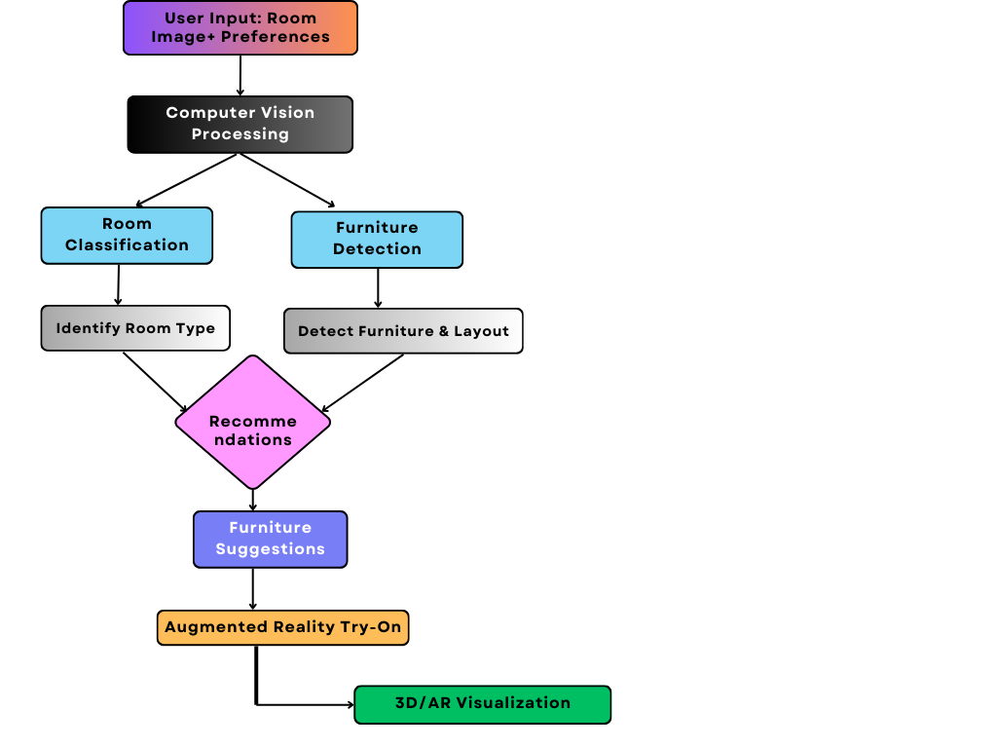
Work Flow

Slide 9
Tools and Technologies
Programming Language & ML : Python, PyTorch
Computer Vision: ResNet, YOLOv8, OpenCV
Visualization: Matplotlib, Chart.js, Three.js, jsPDF
Frontend : Html, CSS, JS, React.js (18.2.0), Vite (6.3.1), Ant Design (5.12.2), Axios
Backend & Deployment: FastAPI, Uvicorn, Poetry (dependency management), RESTful APIs
Database: SQLite (via SQLAlchemy ORM)
Generative AI Models: For generating and recommending new designs - Stable Diffusion model - runyml/stable-diffusion-v1-5, Google Gemini 2.0 Flash
Augmented Reality / 3D Tools - Three.js — for 3D visualization and interactive previews.
Document Generation: jsPDF + html2canvas — for PDF report creation and export
Operating System: Windows

Slide 10
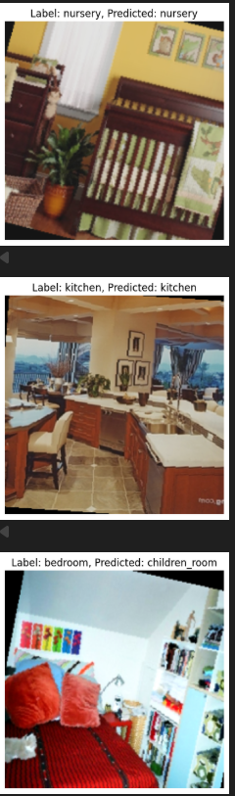
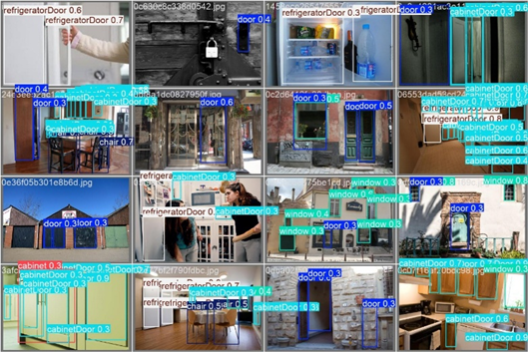
Results
Room Classification using RESNET 18:
Furniture Detection using YOLOV8

Slide 11
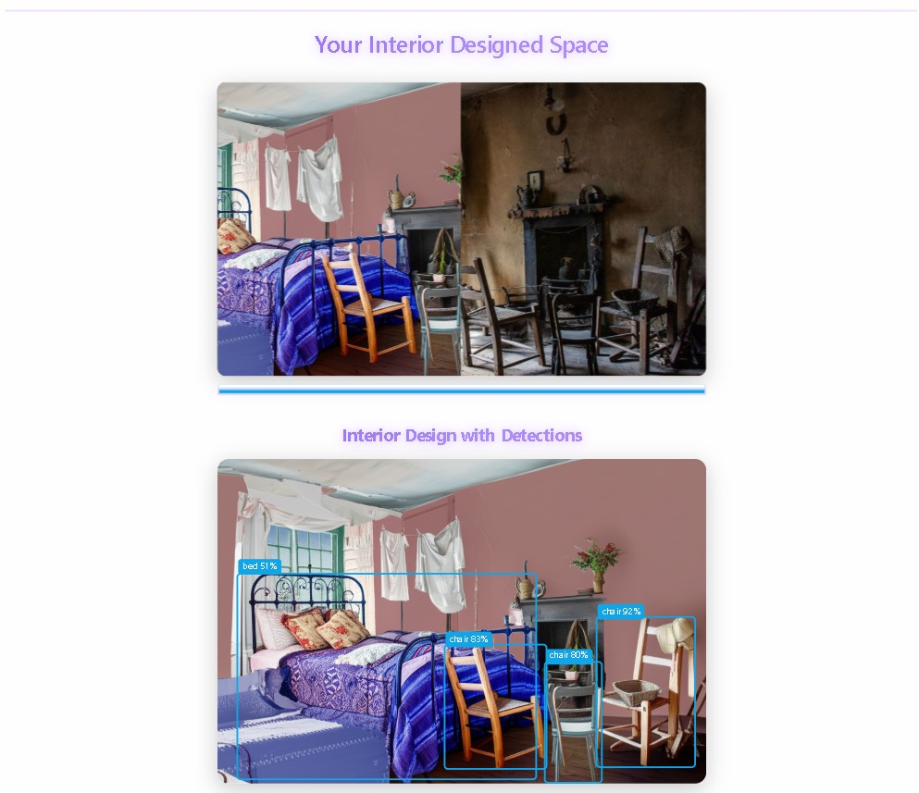
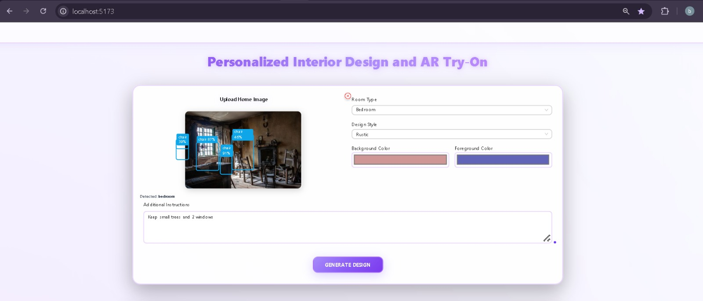
Results

Slide 12
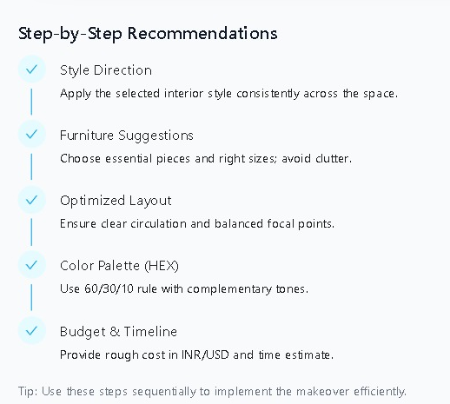
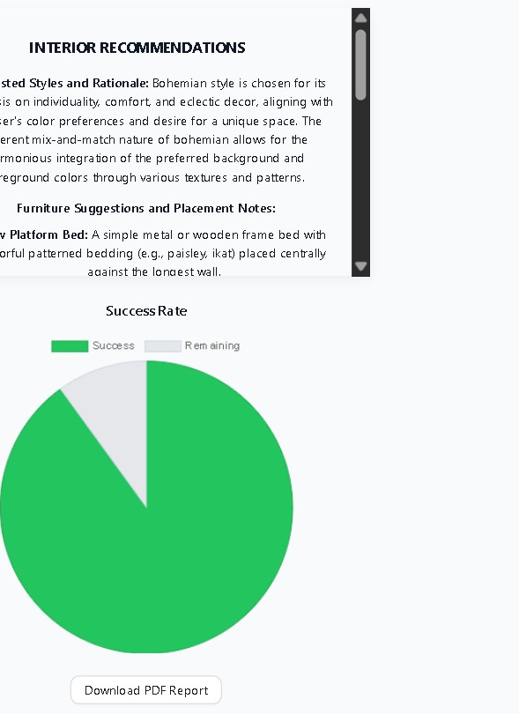
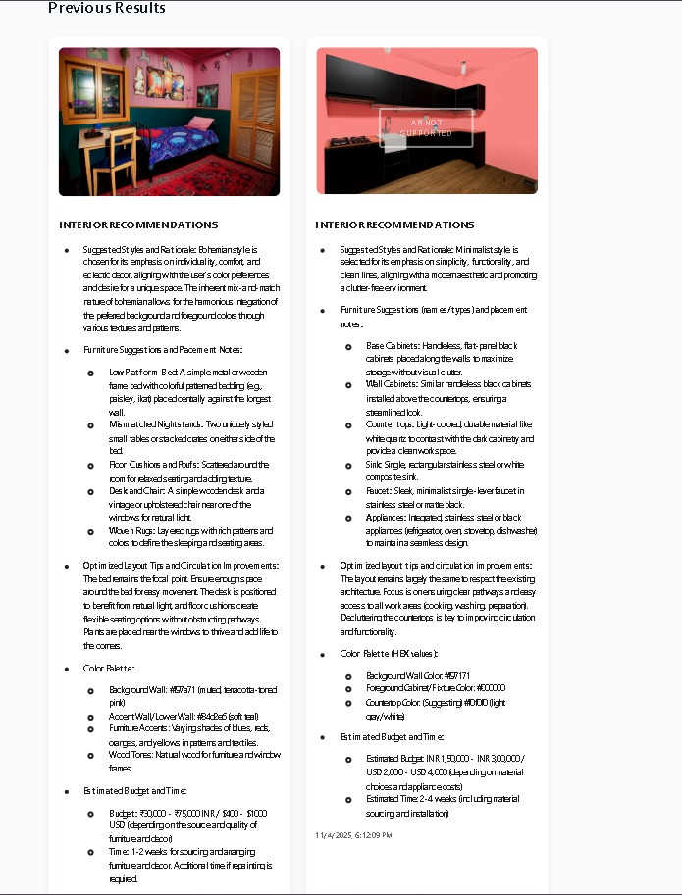
Results

Slide 13
Conclusion and Future Scope
We successfully developed a smart system that reduces the interior design visualization gap.
Our integrated AI pipeline provides a personalized, interactive, and user-friendly experience.
It successfully reduces the imagination gap between design and reality.
Future Scope
Integrate e-commerce for real products.
Enhanced AR: Develop a mobile AR mode using the phone's camera for real-time overlay.
User Accounts & Gallery: Let users save and manage their design history.

Slide 14
Individual Contribution
Team Memebers | Primary Responsibilities
Mohitha Bandi | Backend & Integration Lead: Built the FastAPI server, integrated the YOLOv8 model for furniture detection, implemented the pipeline, and connected the frontend and backend.
Pailla Bhavya | AI/ML Lead: Researched, trained, and fine-tuned the ResNet18 model for room classification. Managed the dataset, handled class imbalance, and integrated the model into the backend.
T. Harshavardha Reddy | Frontend Lead & UI/UX: Developed the React application, implemented Ant Design components, built the interactive 3D viewer with Three.js, and created the PDF report generation feature.

Slide 15
Demo Section
GitHub Repository Link: https://github.com/id12026/A-Smart-System-for-Personalized-Interior-Design-AR-Try-On.git
Demo Link: https://drive.google.com/file/d/1XXW9fWHQQUhFWhLOHMcPthoh5N9CLa9r/view?usp=sharing

Slide 16
Thank You

